Slide 1

Governmental Actions and Advisory Opinions Regarding Human Genome Editing
Hervé Chneiweiss
Président du Comité d’éthique de l’Inserm
Neuroscience Paris Seine – IBPS (Cnrs – Inserm – UPMC)
Paris France

Slide 2
Declaration of links of interest
President of the Ethic committee of INSERM (French National Institute for Research in Health and Medicine)
Member of Unesco’s International Bioethic Committee
Former member of the French National Ethic committee (CCNE 2013-17)
Head Neuroscience Paris Seine – IBPS (CNRS/INSERM/Sorbonne University)
Neurologist Neuro-Oncology dpt La Salpétrière
Vice-President of ARRIGE (Association for Responsible Research and Innovation in Genome Editing)
I declare that I have no conflict of interest concerning the data contained in this presentation

Slide 3
Genome editing in France
First Opinion of Inserm Ethic Committee in 2015
It seemed immediately important to distinguish three areas associated with different issues:
1/ application of the technology to humans, which essentially raises the question of germ line modifications;
2/ application to animals, particularly “pest” species, which raises the question of potential horizontal gene transfer and the emergence of irreversible damage to biodiversity;
3/ risks of damage to the environment.
« To encourage research aimed at evaluating the efficacy and safety of CRISPR technology and other recently published genome editing technologies, in experimental models that can allow case-by-case determination of the benefit/risk balance of a therapeutic application, including any applications that involve germ cells and the embryo. »
« To comply with the prohibition of any modification of the germ line nuclear genome for reproductive purposes in the human species, and not support any application to modify the legal conditions until uncertainties about the risks have been clearly evaluated, and until a broad consultation involving multiple partners from civil society has ruled on this scenario. »

Slide 4
State of the art in France
Gene therapy of somatic cells has been promoted since the end of the 90s with seminal advances such as treatments for severe immune deficit (SCID-X, Wiscott-Aldrich, M. Cavazzana & A. Fischer), ß-Thalassemia (M. Cavazzana) or adrenoleukodystrophy (M. Cavazzana & N. Cartier).
In 2018 our FDA-like regulatory agency (ANSM, Agence National de Sécurité des Médicaments) approved CAR-T treatments in some specific cancers
Pre-Implantation Genetic Diagnosis (PGD) is allowed since 1994 for licenced centers (5 presently) under the supervision of Agence de la Biomédecine (ABM).
Research on human embryos falls under two distinct rules according to their potential development:
- Licence from ABM for basic research leading to the destruction of the embryo at the end of the research
- Licence from ANSM for research on ART

Slide 5
Article 16-4 of the French Civil Code Law n°2004-800 of 6 août 2004 - art. 21
No one can undermine the integrity of the human species. (Nul ne peut porter atteinte à l'intégrité de l'espèce humaine.)
Any eugenic practice tending to the organization of the selection of persons is prohibited. (Toute pratique eugénique tendant à l'organisation de la sélection des personnes est interdite.)
Any intervention aimed at giving birth to a genetically identical child to another living or dead person is prohibited. (Est interdite toute intervention ayant pour but de faire naître un enfant génétiquement identique à une autre personne vivante ou décédée.)
Without prejudice to research aimed at the prevention and treatment of genetic diseases, no modification can be made to genetic traits in order to modify the offspring of a person. (Sans préjudice des recherches tendant à la prévention et au traitement des maladies génétiques, aucune transformation ne peut être apportée aux caractères génétiques dans le but de modifier la descendance de la personne.)

Slide 6
Article L2151-2 Public Health codeLaw n°2011-814 du 7 juillet 2011 - art. 40
In vitro embryo design or cloning of human embryos for research purposes is prohibited. ( La conception in vitro d'embryon ou la constitution par clonage d'embryon humain à des fins de recherche est interdite.)
The creation of transgenic or chimeric embryos is prohibited. (La création d'embryons transgéniques ou chimériques est interdite.)

Slide 7
France signed and ratified the Oviedo convention
Article 13 – Interventions on the human genome
An intervention seeking to modify the human genome may only be undertaken for preventive, diagnostic or therapeutic purposes and only if its aim is not to introduce any modification in the genome of any descendants.
Article 18 – Research on embryos in vitro
Where the law allows research on embryos in vitro, it shall ensure adequate protection of the embryo.
The creation of human embryos for research purposes is prohibited.

Slide 8
Revision of the French bioethic laws 2019
Debates on
What is a transgenic or a chimeric embryo?
Numbers of days in vitro allowed for embryo research (7, 14, 21?)
Changes to art 13 of Oviedo to allow, if demonstrated safe enough, gene therapies aimed at treating severe genetic diseases (with proposal of a list)
Opinions of the National ethic Committee (CCNE), the Supreme Court (Conseil d’Etat) and the Parliament Office of Assesment of Science and Technologies (OPECST) open for a more science-driven approach if a medical benefit is possible

Slide 9
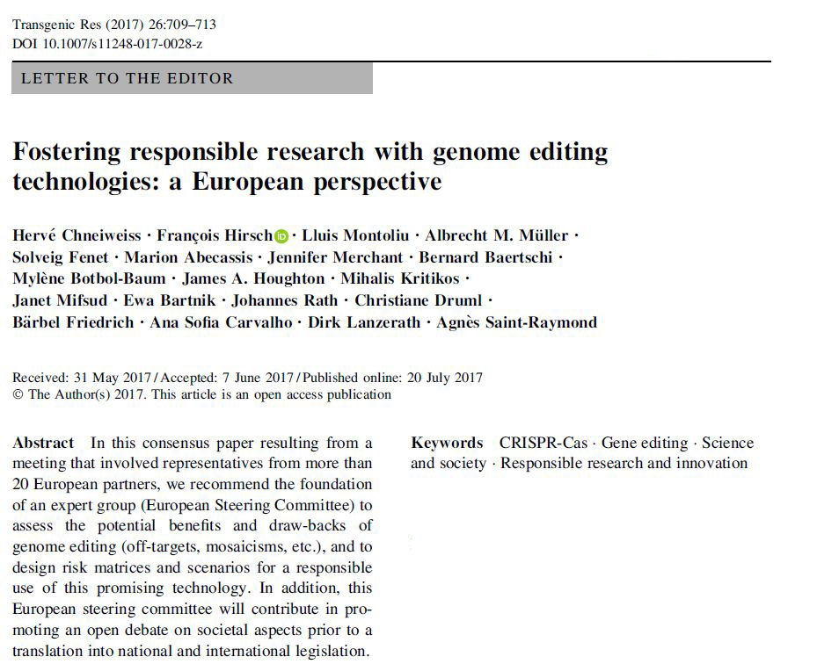
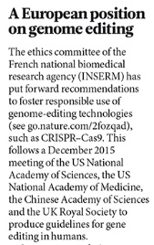
Nature (2017) Hirsch et al.
Initial pre-ARRIGE 2017 publications in Nature and Transgenic Research

Slide 10
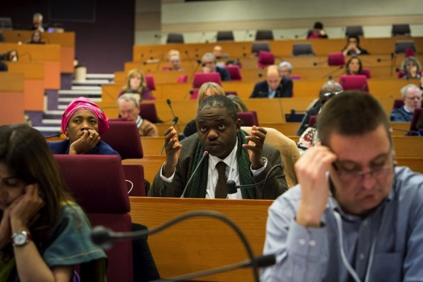

http://arrige.org
Launched on 23 March 2018 from Paris
Over 400 people registered from all over the world
Becoming a formal association (administrative registration in France)
ARRIGE Web site: https://arrige.org
ARRIGE Twitter account: @ArrigeOrg
ARRIGE Facebook page: https://www.facebook.com/arrige.org
ARRIGE YouTube channel: https://www.youtube.com/channel/UCc4KSY7P3nc1CTLWtAZt0jA
ARRIGE blog: https://arrige.org/blog
ARRIGE forum: https://arrige.org/forum
Internal distribution email list (→ arrige@cnb.csic.es)
SLACK discussion channel: https://arrige.slack.com/
Association for Responsible Research and Innovation in Genome Editing

Slide 11
Aims:
Fostering the development of genome editing technologies within a safe and ethical framework for individuals and for our societies.
Fostering an inclusive debate with a risk-management approach, taking into account the human, environmental, animal and economic issues
Promoting a global governance of genome editing through a comprehensive setting for all stakeholders
Creating an ethical tool box and informal guidance for genome editing technology users, regulators, governance and the civil society at large
Developing a robust particular reflection on the role of the lay public in this debate and the necessity for improved public engagement
http://arrige.org

Slide 12
To contact Inserm Ethics Committee
Comite-ethique@inserm.fr and INSERM web site
For info about ARRIGE see
https://arrige.org
Thank you for your attention

Slide 13
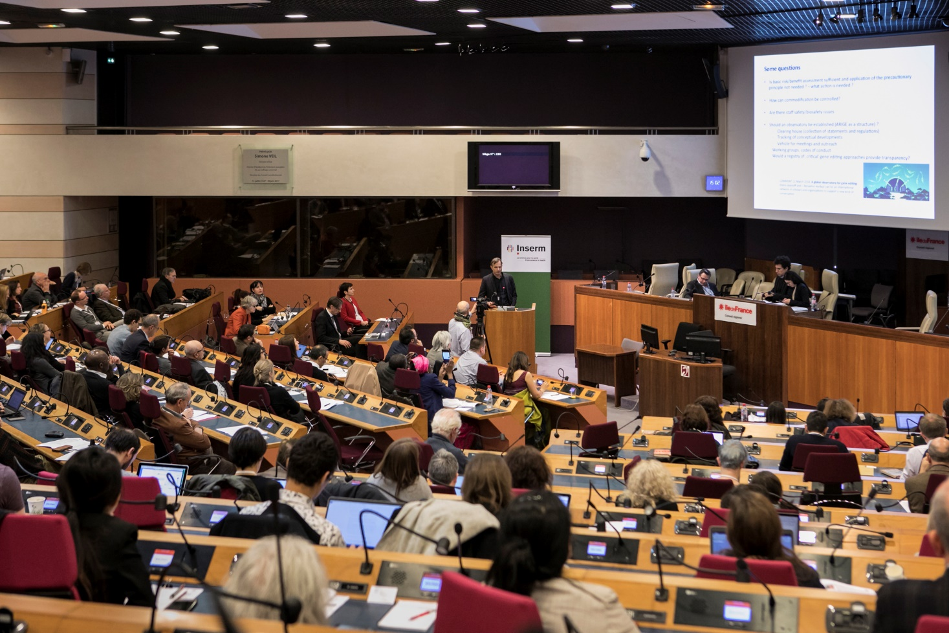
ARRIGE Kick-Off meeting, Paris, 23 March 2018
Association for Responsible Research and Innovation in Genome Editing

